Slide 1
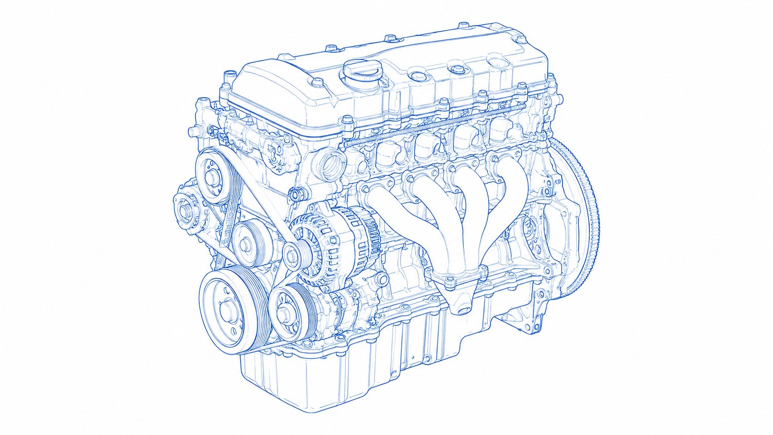
VITALS-Edge
Vehicle Intelligent Telemetry & Anomaly-Learning System
TATA Technologies InnoVent Hackathon– 26
PS: 3.2.1.3. Edge AI for Vehicle Health and Predictive Maintenance
Team – From Sri Eshwar College of Engineering
Mithun M | Final Year - AI&DS
Mohammed Rafi H | Final Year - AI&DS
Dhivyadharshini R | Pre-Final Year - AI&DS
Sandeep Prabakar | Pre-Final Year - Cyber Security
Thejeswini S | Pre-Final Year - Cyber Security

Slide 2
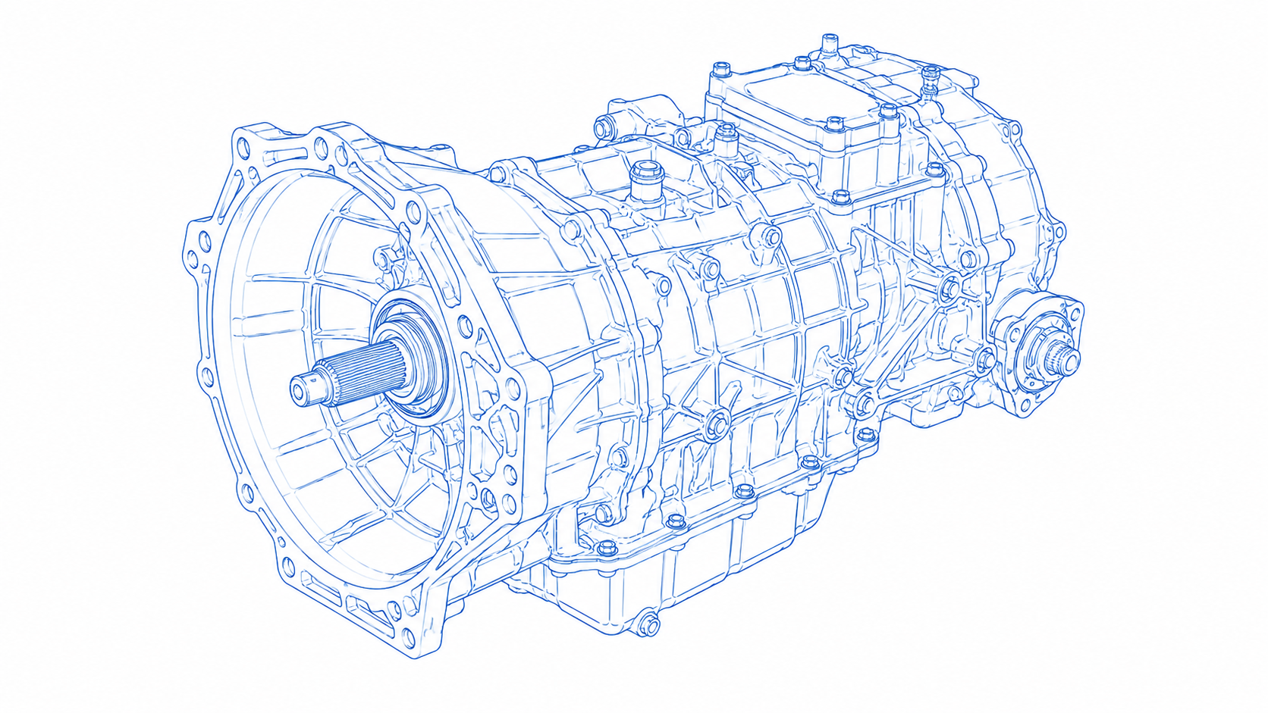
PROBLEM STATEMENT
Sudden Breakdown of Vehicles due to poor maintenance can dramatically cut down downtime, maintenance spend and disrupt schedules.
Critical pain Points are
Unplanned Downtime: Upon deployment of small fleets, unplanned downtime can lead to disruption of schedules and may lead to stop revenue. Productivity Loss due to Idle vehicles leads to idls crews and delayed jobs and customer dissatisfaction
Safety and Compliance: Poor maintenance can threat public safety and regulatory compliance. Safety Studies found that Fleets with maintenance violations are 65% more likely to crash. Compliance violations can lead to fines or service bans
Maintenance Cost: Reactive repairs provides sudden inflation in budgets. Predictive repairs reduces productivity when fleets are healthy. Older assets can cause huge maintenance cost also degrades fuel efficiency while reducing asset life.
Technical Challenges
Data Quality and connectivity: Vehicles generate noisy, incomplete telematics data. Edge devices must buffer data through intermitterntseamless connectivity but remote or low bandwidth areas challenge real-time analytics.
Model complexities: Training accurate models demands both clean and failure data which are scarce in real-time. Building high-fidelity digital twin model also incurs heavy computation and modelling effort.
Edge Constraints: On-board system have limited compute capacity, though IoT sesors cost have plunged and integrating them to fleets still requires capital and careful integration
Integration and culture: deployment of AI into legacy fleet operations is non-trivial. Sudden upgrade in culture and technology leads to skill gaps from technicians creates slow adaptation

Slide 3
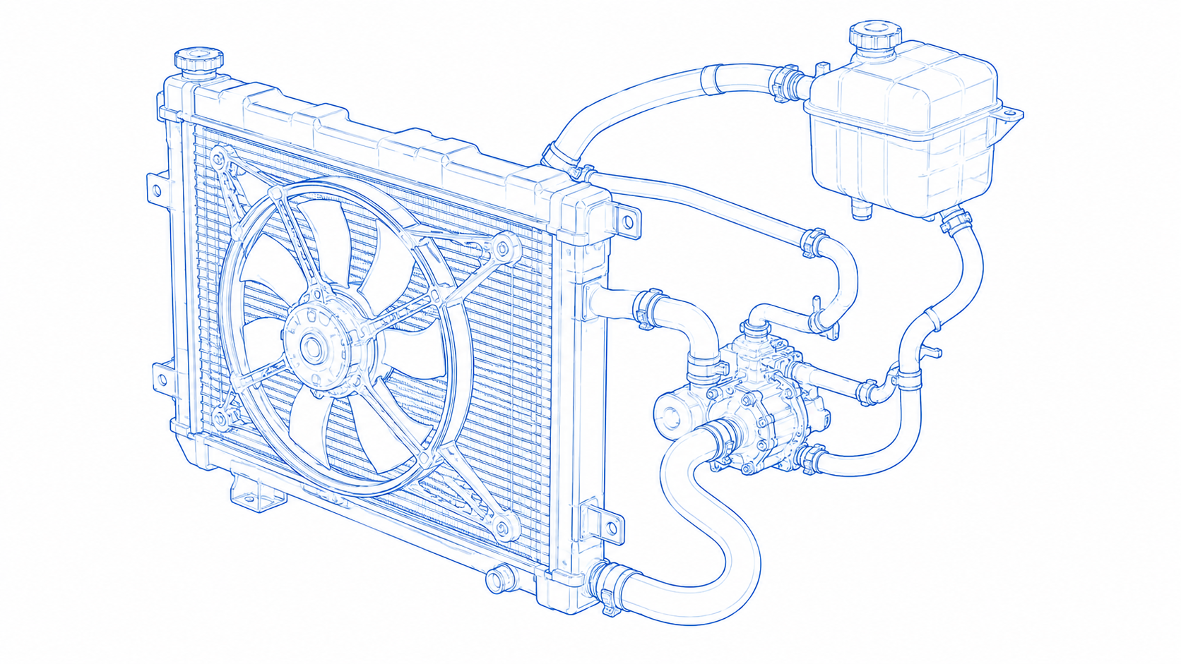
EXISTING SOLUTIONS
Cloud-Based Telematics & OEM Platforms
Vehicles stream sensor/telematics data to remote serves for analysis. OEM offers their own cloud services.
Architecture: On-Board -> cellular -> cloud analytics platform -> alerts to fleet managers [Data is stored centrally]
Disadvantages:
Latency and Connectivity: Cloud processing causes network delays. Bandwidth links may be transient or low which can miss or delay fault alerts.
Data privacy and security: continous vehicle data uplinks raise privacy and security concerns. Edge processing is to enhance data privacy by keeping data local but does not have storage or higher computation. Implication os cloud models may risk in data leakage
Model drift & maintenance: Models trained under a single environment may get degraded as vehicles age or usage patterns change. Updating cloud models requires continual re-labelling.
Edge/On-Device Rule-Based Systems
Simple diagnostics or predictions can run on vehicle’s ECU or gateway [for example: processing of threshold alerts, fault codes, vibration warnings, etc.,] No complex ML.
Architecture: Local sensors -> ECU -> on board software -> dashboard warnings
Disadvantages:
False Alarms / delayed Alerts: Fixed rules can generated many false positives and negatives. Threshold based monitoring produces alerts not aligned with how machines actually operate, causing reliability issues. Drivers also often ignore to check engines or ignore alerts and only notice at failure’s end.
Limited Scope: Rule systems detect only known failures. They cannot predict complex interactions. No learning means no improvement from data.
Low Explainability / Visibility: System offering minimal insights causes confusion among technicians due to poor explanation leads to limiting trust
Digital Twins
A digital twin is a detailed virtual replica of a vehicle or its subsystems, continuously updated with real-time data. In PdM, the twin can simulate wear and predict failures by comparing observed behavior to simulated healthy models.
Disadvantages:
Complexity and Cost: Building and maintaining accurate twins is expensive. It requires detailed vehicle models, specialized software, and calibration.
Data and Integration: Twins rely on diverse data (CAD models, sensor feeds, maintenance records). Integrating all this – especially for legacy vehicles – is very difficult.
Compute and Scalability: Running simulations in real time for every vehicle pushes computational limits.
Security and Privacy: digital twin platforms aggregate sensitive data. Ensuring secure, compliant implementation is challenging.

Slide 4
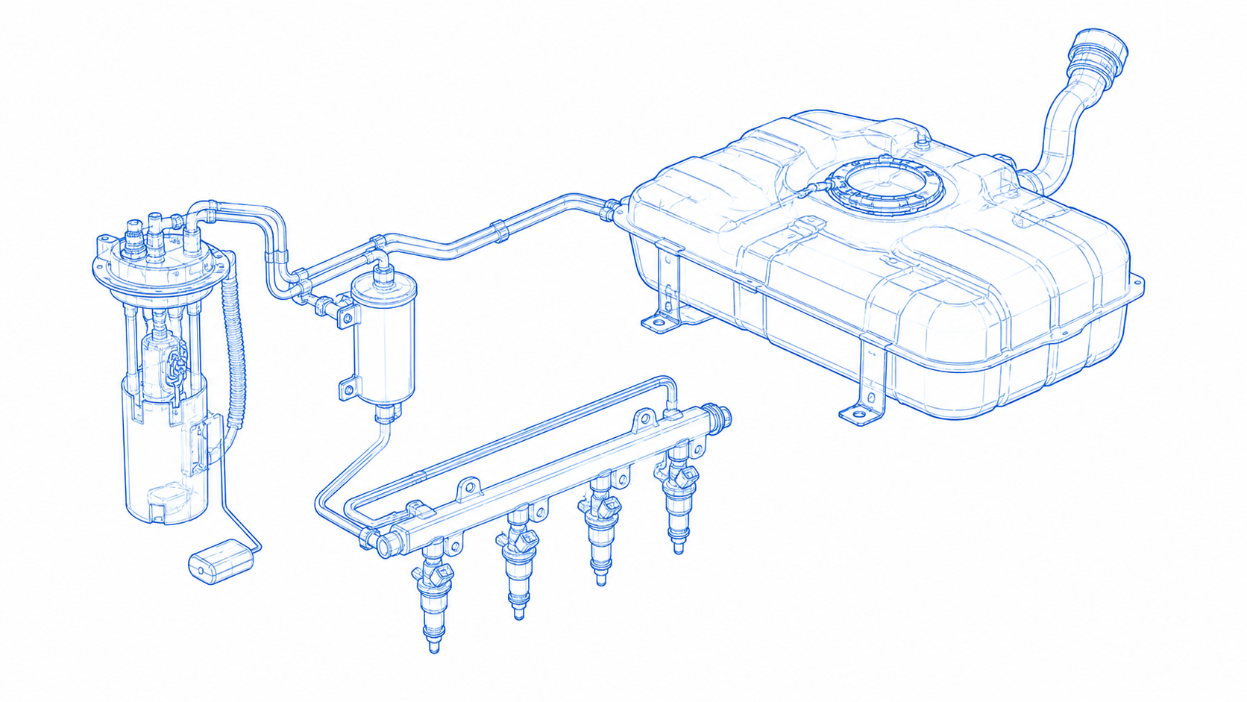
EXISTING SOLUTIONS
Cloud ML (RUL/Anomaly) Models
To build machine learning models, data are being sent to cloud. Models may use supervised training or unsupervised anomaly scores.
Architecture: Vehicles sensors -> data lake -> feature extraction -> ML models -> predicted RUL -> Maintenance alerts
Disadvantages:
Data & Labelling: Supervised RUL models require failure examples. Actual failures are rare and poorly logged. Without labels, unsupervised or heuristic methods must be used, which are less reliable
Domain Gap: Models trained on C-MAPSS or lab data may not generalize to complex vehicle drivetrains. cloud ML often suffers “model drift” when field conditions differ.
Explainability: Complex ML models (deep nets, ensembles) are black boxes. Operators struggle to trust “ghost alerts” without clear reasons. Edge-case anomalies may go unexplained, hindering diagnosis.
Connectivity & latency: Cloud ML requires constant data upload and inference in the cloud. Network outages or slow links can mean missing a fast-developing fault.
Costs & maintenance: Training/hosting large ML models is costly. Moreover, models must be re‑trained for new vehicle types or updated fleets, adding to total cost of ownership.
Hybrid Edge–Cloud Approaches
This is the combination of Local (Edge) inference with Cloud Anlaytics
Disadvantages:
System Complexity: Developing and maintaining a hybrid system is more complex. Requires careful orchestration
Residual Connectivity Needs: Even with local processing, these architectures still rely on cloud periodically.
Cost & Expertise: Hybrid solutions often demand both edge hardware upgrades and cloud services, raising total costs.
Model Maintenance: Split models can suffer drift on the edge side as conditions change

Slide 5
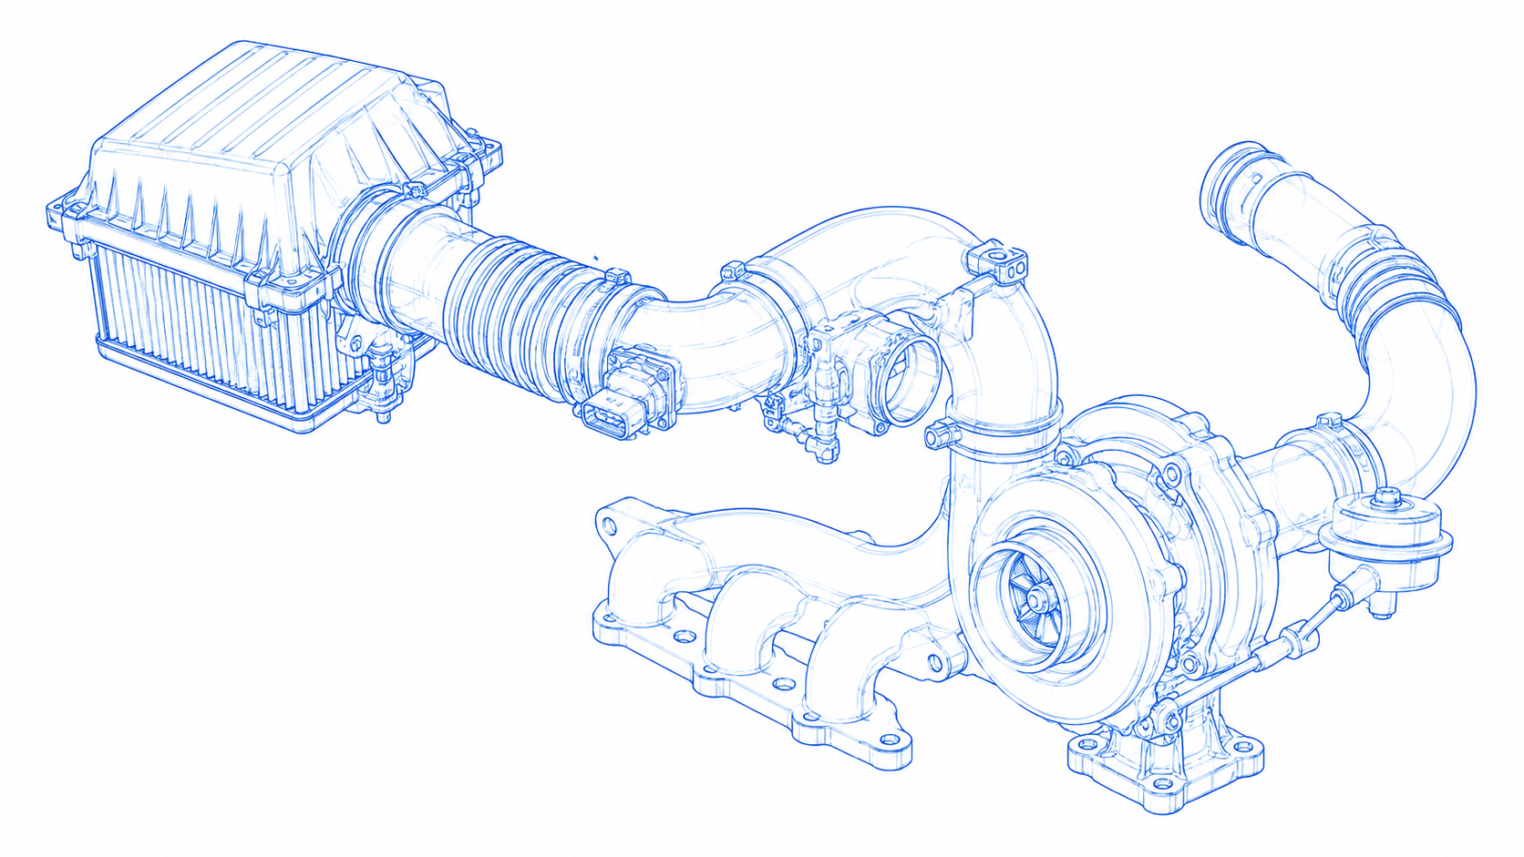
PROPOSED SOLUTION
VITALS-Edge is an edge-first AI platform that performs real-time vehicle health monitoring and predictive maintenance directly on the vehicle instead of relying on continuous cloud processing.
  Unlike existing cloud-centric solutions, VITALS-Edge brings intelligence to the asset itself, allowing vehicles to detect developing faults, estimate Remaining Useful Life (RUL), and generate maintenance recommendations even when internet connectivity is unavailable.
The system continuously collects data from CAN/OBD-II, vibration sensors, temperature sensors, pressure sensors, and other vehicle telemetry. Instead of transmitting every sensor reading to the cloud, the raw data is processed locally using a lightweight preprocessing pipeline that extracts meaningful features such as vibration frequencies, temperature trends, and operational load.
These processed signals are then analyzed by two complementary AI models running entirely on the edge device.
  The first is an unsupervised anomaly detection model (Autoencoder/Isolation Forest), capable of learning normal operating behavour and detecting previously unseen failure patterns without requiring labelled fault data. This directly addresses one of the industry's biggest challenges—the scarcity of labelled mechanical failure datasets.
  The second is a CNN-LSTM Remaining Useful Life (RUL) prediction model, which estimates how long a component can safely operate before maintenance becomes necessary, enabling condition-based servicing instead of calendar-based maintenance.
Once predictions are generated, a local decision engine classifies vehicle health into Healthy, Watch, Warning, or Critical states and immediately triggers alerts on the edge device because all critical inference happens locally, the vehicle continues detecting failures even if cellular or cloud connectivity is lost.
Only compact alert packets (typically less than 1 KB) containing health status, anomaly score, fault type, and RUL estimate are transmitted to the cloud, reducing bandwidth consumption while preserving sensitive operational data.
This directly solves the industry's concerns regarding network latency, expensive cloud transmission, and data privacy, which are common limitations of cloud-dependent predictive maintenance systems.

Slide 6
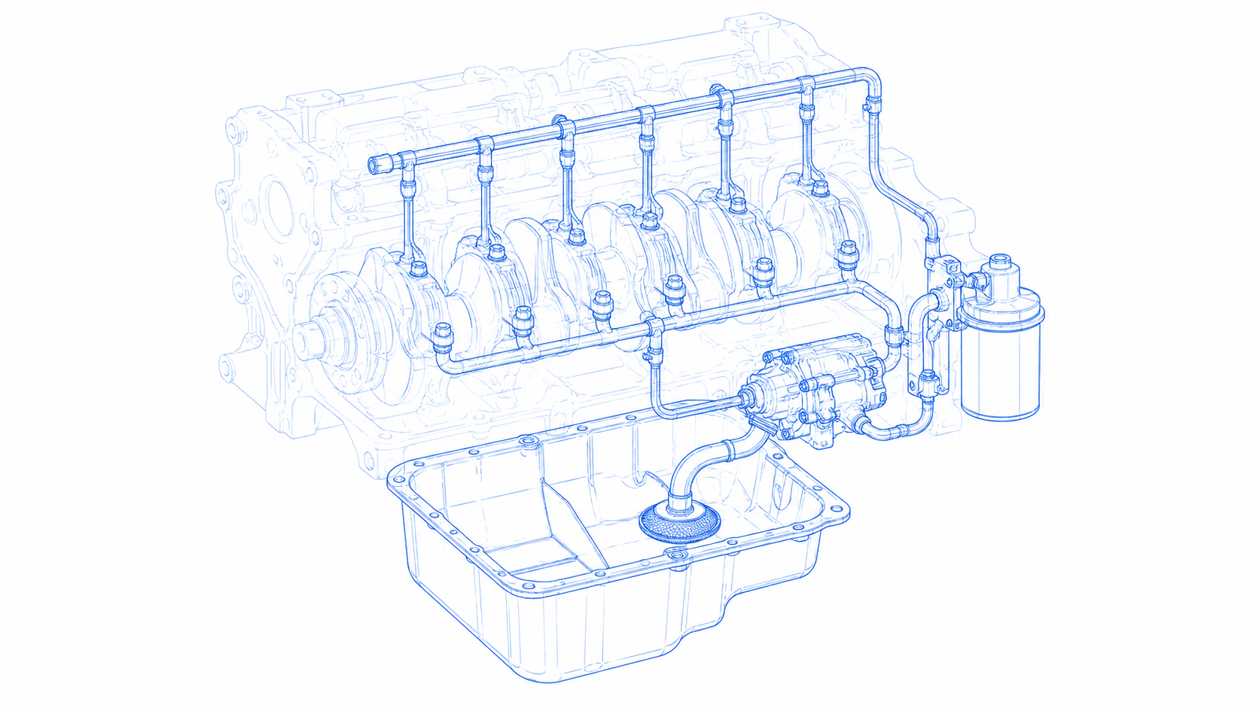
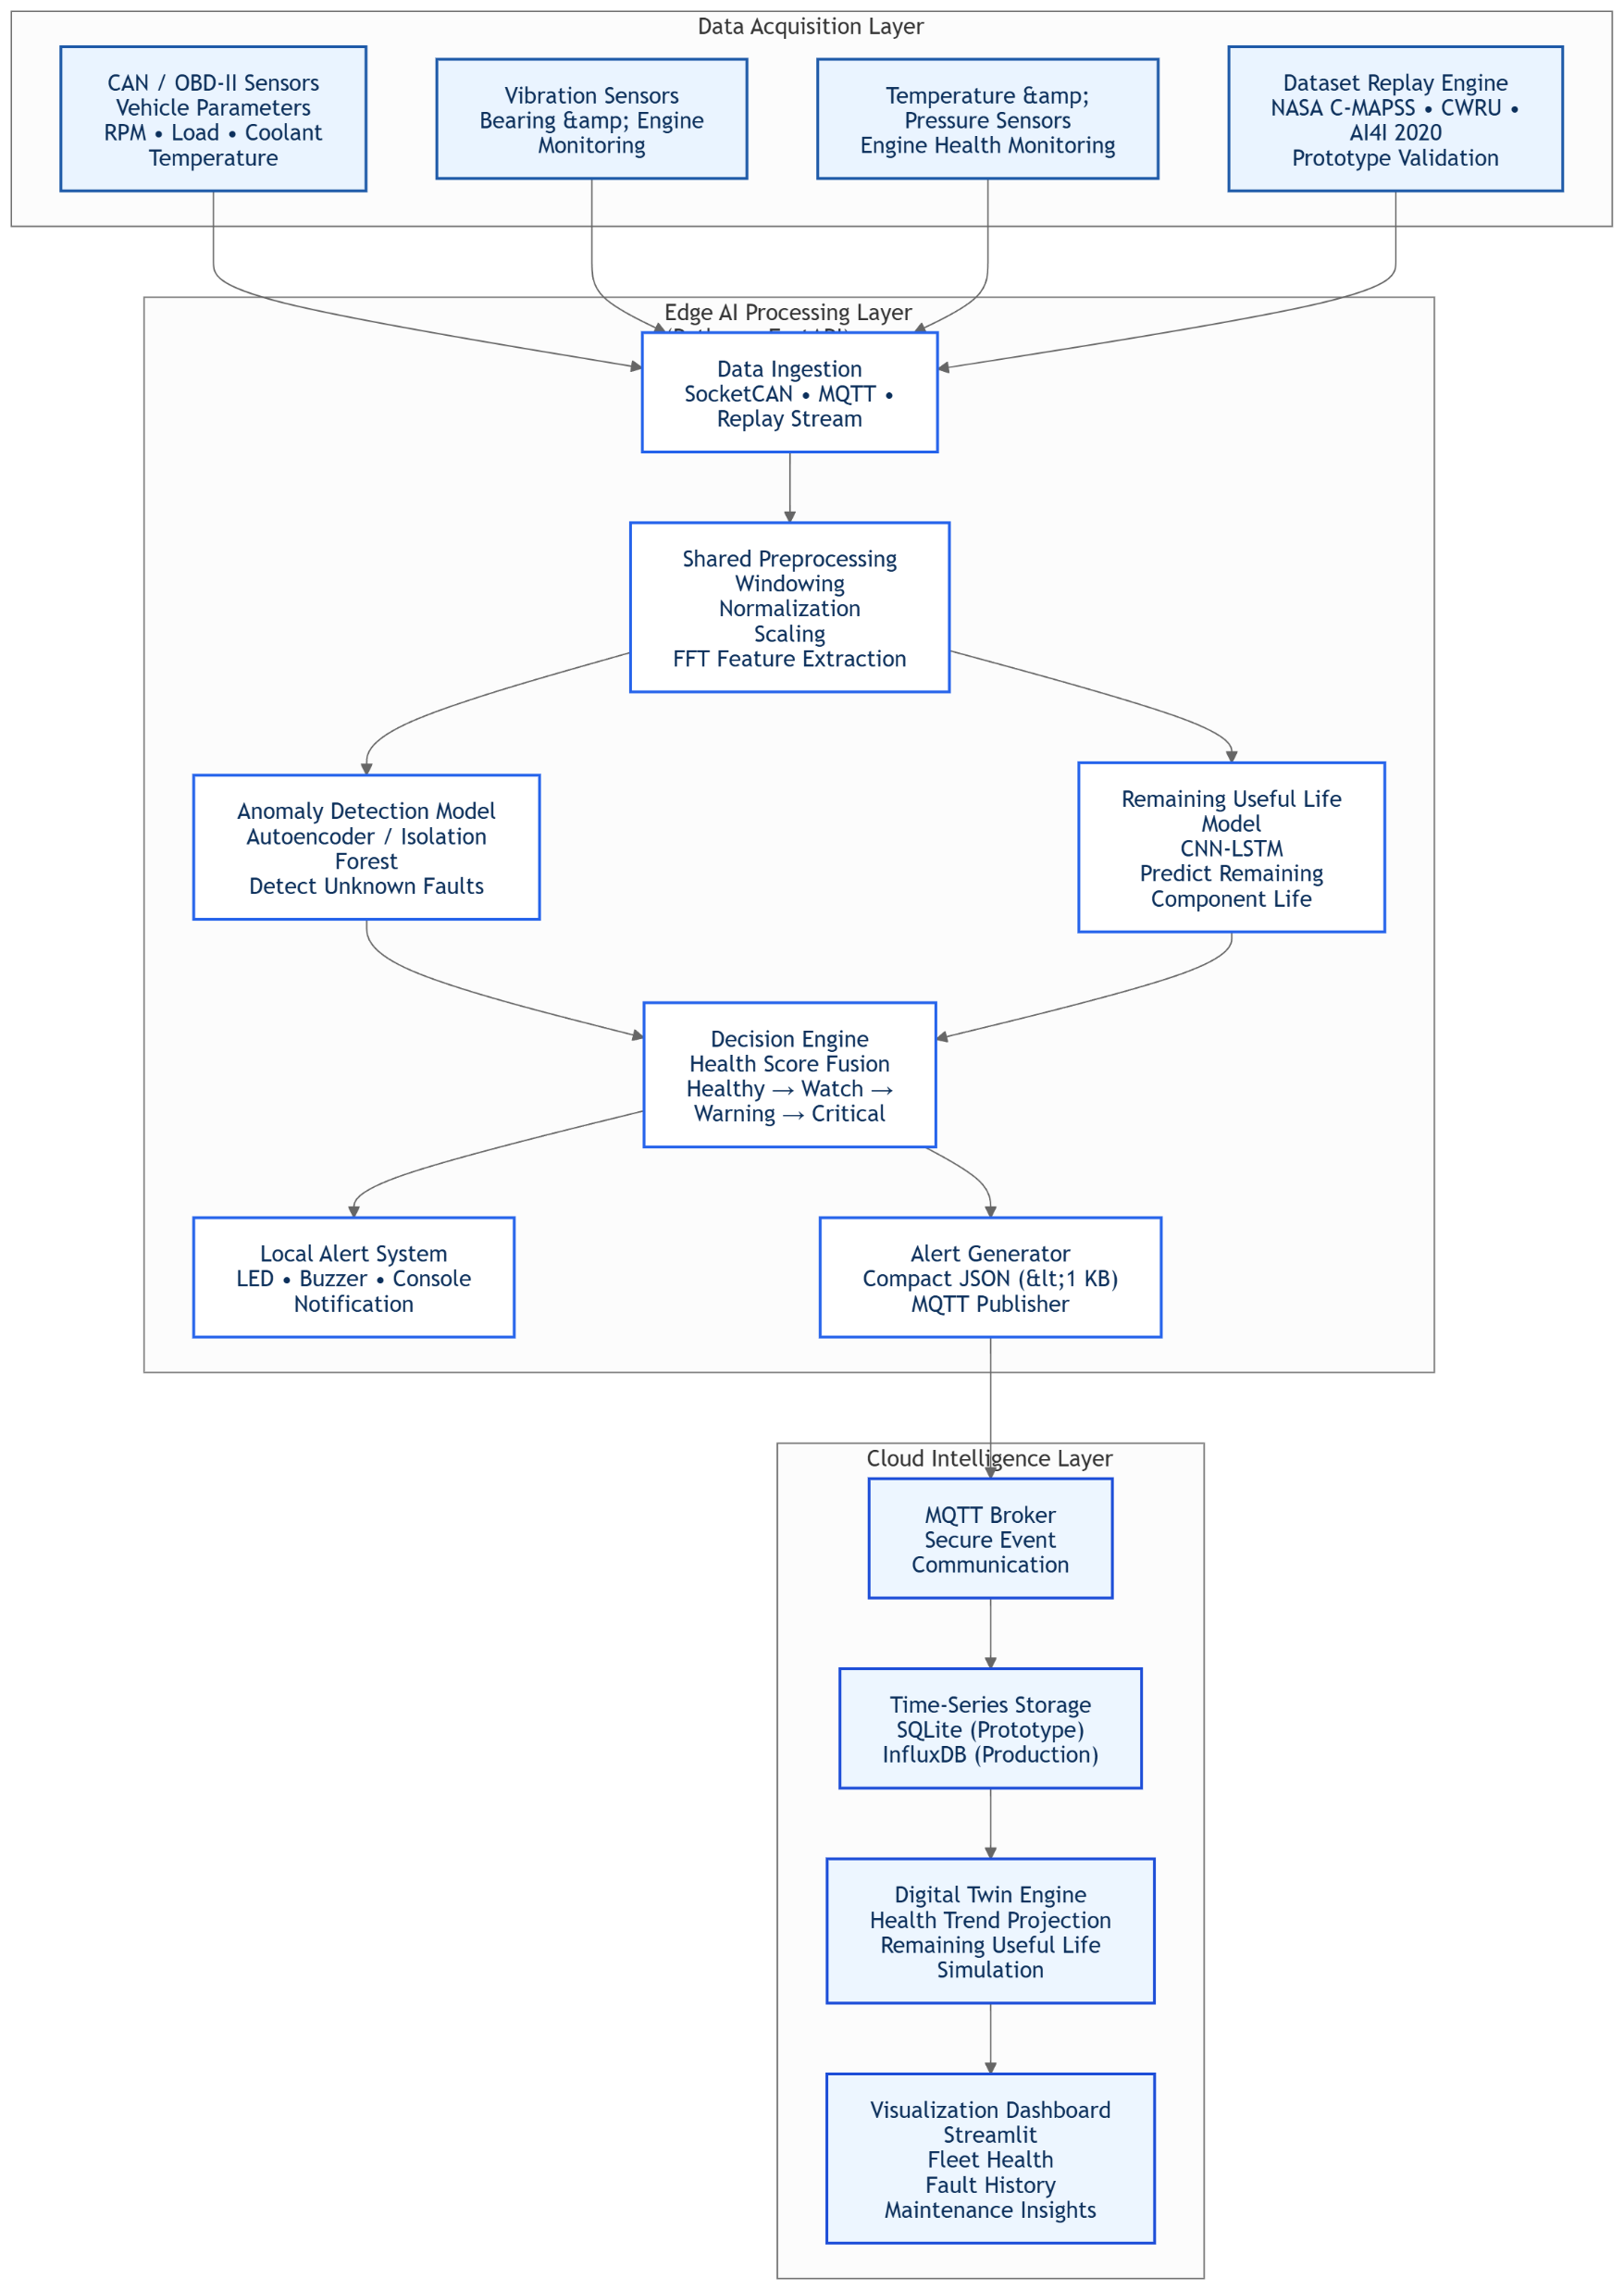
SYSTEM ARCHITECTURE
The VITALS-Edge architecture follows an edge-first, three-layer design consisting of the
  Data Acquisition Layer
  Edge AI Processing Layer
  Cloud Intelligence Layer.
Vehicle telemetry is continuously collected from CAN/OBD-II, vibration, temperature, and pressure sensors, while a dataset replay engine enables prototype demonstration without a physical engine.
The incoming signals are processed through a shared preprocessing module that performs windowing, normalization, scaling, and FFT feature extraction to ensure identical processing during both training and inference.
The processed features are passed to two AI models running locally on the edge device using ONNX Runtime (or TensorRT INT8 on NVIDIA Jetson): an Autoencoder-based Anomaly Detection model for identifying abnormal operating conditions and a CNN-LSTM Remaining Useful Life (RUL) model for estimating component life.
Their outputs are combined by a Decision Engine that evaluates fault severity and classifies the vehicle health into Healthy, Watch, Warning, or Critical states.
When a fault is detected, the system immediately triggers local alerts and simultaneously generates a lightweight JSON alert (<1 KB).
Only these compact health events are transmitted through MQTT to the cloud, minimizing bandwidth while allowing the vehicle to continue operating even during complete network loss.
The cloud layer validates and stores incoming events in SQLite (prototype) or InfluxDB (production), where a lightweight Digital Twin projects degradation trends and Remaining Useful Life.
Finally, a react.js dashboard visualizes live health status, fault history, RUL countdown, digital twin model and maintenance recommendations for engineers.

Slide 7
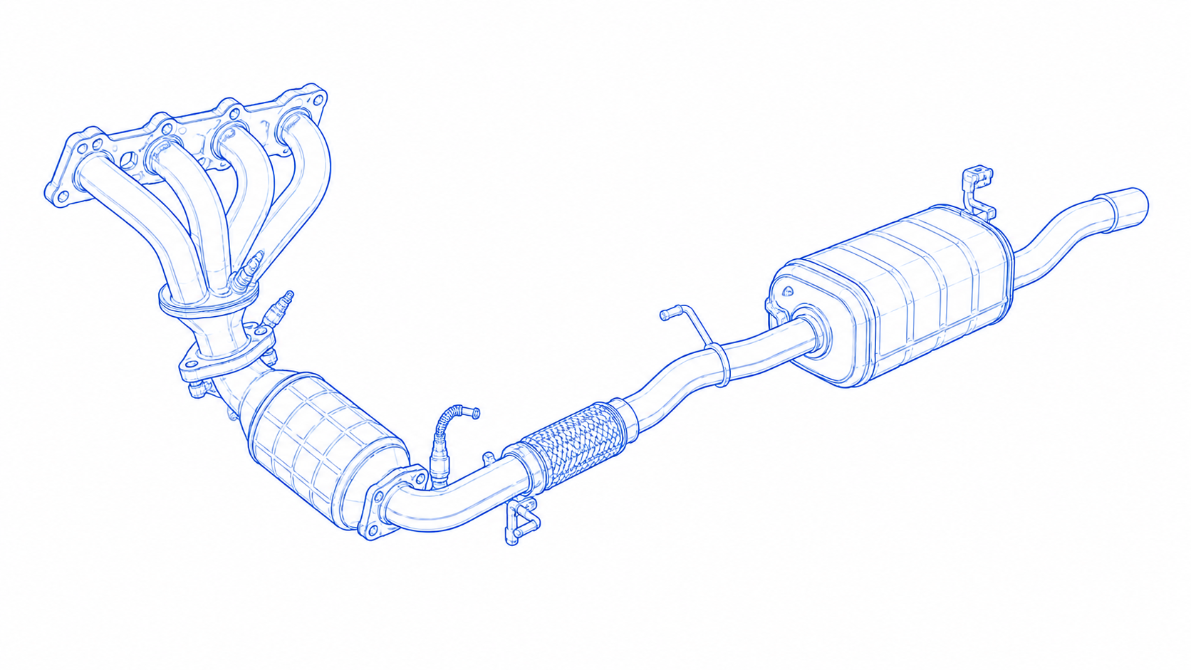
INNOVATION
The core innovation lies in combining multiple proven technologies into a single deployable workflow rather than relying on any one algorithm.
  An unsupervised autoencoder learns normal operating behavour and identifies previously unseen faults without requiring large labelled datasets. a major challenge in industrial predictive maintenance.
  CNN-LSTM model continuously estimates the Remaining Useful Life of critical components. A lightweight digital twin validates AI predictions using physics-based degradation trends, providing engineers with transparent and explainable maintenance recommendations instead of black-box outputs.
BUSINESS IMPACT
Traditional cloud-centric systems suffer from network latency, high bandwidth costs, limited offline capability, and low explainability, making them difficult to deploy in remote industrial environments.
Our edge-first architecture performs fault detection and Remaining Useful Life (RUL) prediction locally, ensuring real-time decisions even without internet connectivity. By transmitting only compact health alerts instead of continuous raw sensor streams, operational costs and network usage are significantly reduced while preserving data privacy.
Additionally, integrating AI with a physics-based digital twin improves transparency and trust, overcoming one of the most cited limitations of current predictive maintenance solutions and enabling industries to make faster, more confident maintenance decisions.

Slide 8
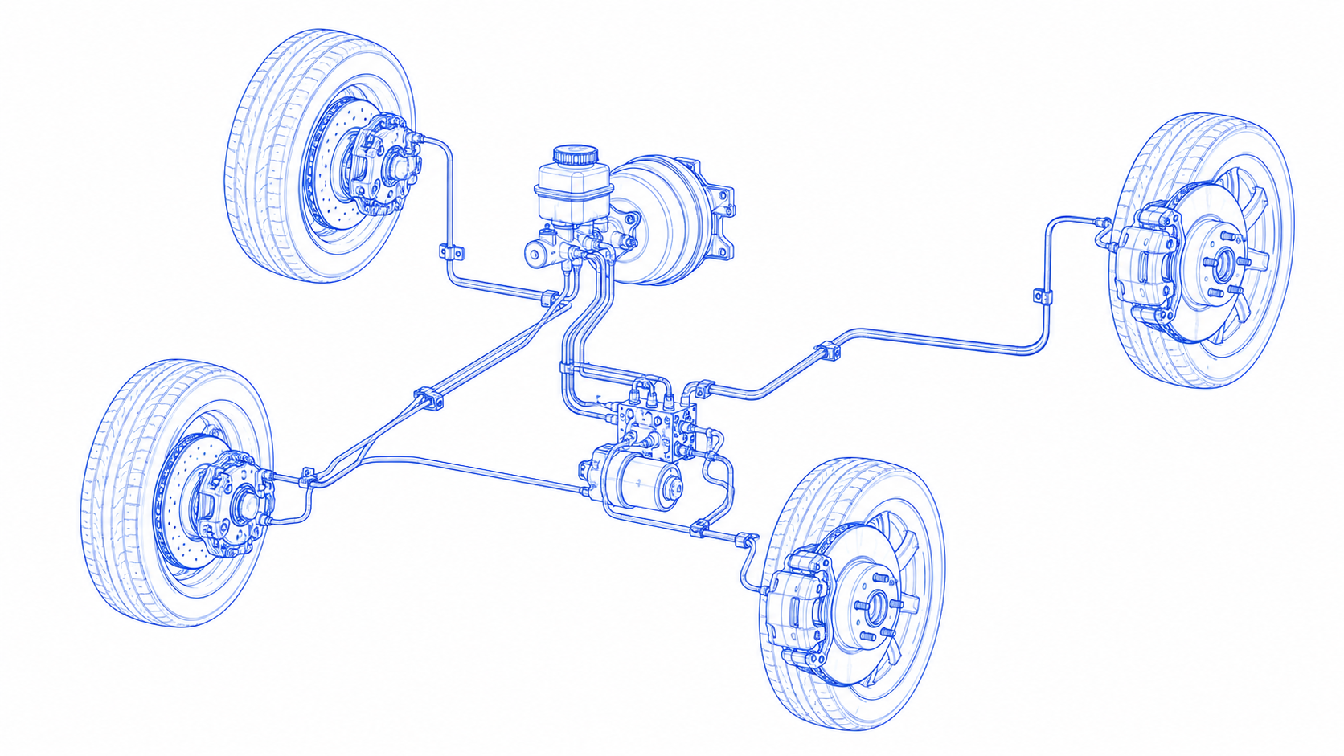
CONCLUSION
VITALS-Edge demonstrates that the future of predictive maintenance lies not in sending more data to the cloud, but in bringing intelligence closer to the asset.
Our solution combines edge AI, unsupervised anomaly detection, Remaining Useful Life (RUL) prediction, and a physics-informed digital twin into a single architecture that addresses the practical limitations of today's predictive maintenance systems.
Unlike conventional cloud-centric platforms, the system continues monitoring vehicle health even during network outages, enabling low-latency fault detection while reducing bandwidth usage and protecting sensitive operational data
What differentiates VITALS-Edge is not the invention of entirely new algorithms, but the practical integration of proven technologies into a deployable edge-first workflow.
The combination of on-device AI inference, lightweight cloud communication, explainable digital twin validation, and hardware-independent dataset replay creates a solution that is technically feasible, scalable, and suitable for real industrial deployment.
This directly addresses major industry challenges including unplanned equipment downtime, delayed fault diagnosis, high communication costs, limited connectivity in remote operating environments, and the shortage of labelled failure datasets.
These challenges are consistently highlighted by organizations such as McKinsey & Company, IBM, NVIDIA, Siemens, and AWS in their predictive maintenance and industrial edge computing research.

Slide 9
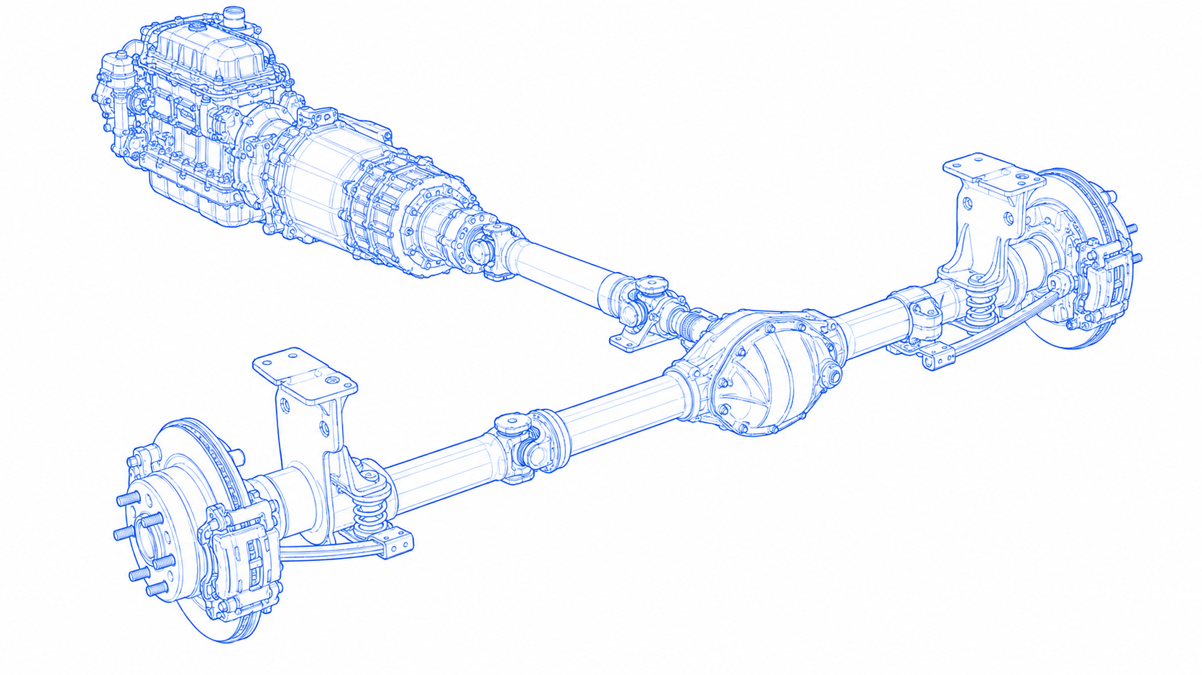
REFERENCES
NVIDIA Embedded Computing
NASA C-MAPSS Dataset
Case Western Reserve University (CWRU) Bearing Data Center
AWS IoT Core
InfluxDB
Raspberry Pi 5
Google Coral TPU
Raspberry Pi Camera Module 3
Analog Devices ADXL335
Bosch BMP390 Sensor
Maxim DS18B20 Temperature Sensor
MCP2515 CAN Controller
Remaining Useful Life Estimation Using Functional Data Analysis
Remaining Useful Life Estimation for Turbofan Engines: A Comparative Study of Classical, CNN, and LSTM Approaches
Isolation Forest
Early Fault Detection on CMAPSS with Unsupervised LSTM Autoencoders
Auto-Encoding Variational Bayes
A Neural Network-Evolutionary Computational Framework for Remaining Useful Life Estimation
TensorRT Documentation
ONNX Runtime Documentation

Slide 10
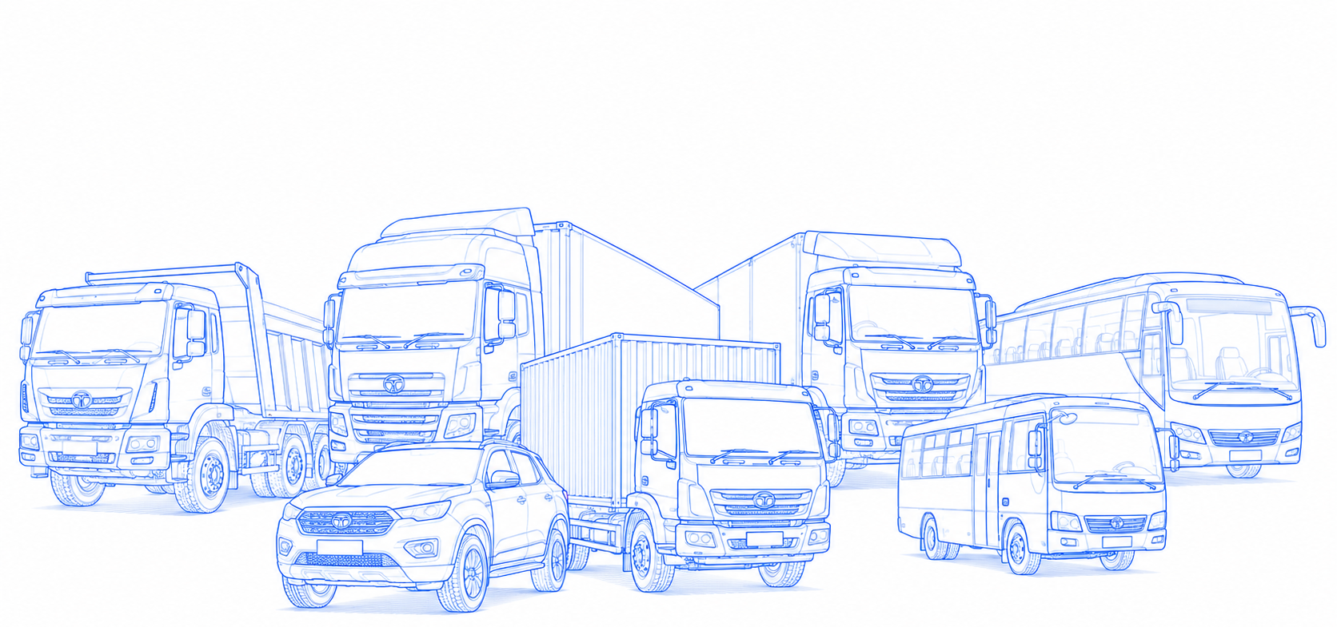
THANK YOU

